Slide 1

IMPACT PLANNING- DIVISIONAL PRIORITIES TOOLKIT
USING DESIGN THINKING AS A TOOL TO ADDRESS BIASES AND BEHAVIOURS THAT HAMPER CREATIVITY AND INNOVATION

Slide 2
TIMELINES
Impact planning concludes for divisions and departments and communication about divisional priorities to employees
By 15th Feb
TTT for Line managers for impact planning
Mid Jan- Feb, 2023
Closure of all action planning on system
March, 2023
TTT for HRBP for impact planning
9- 20th Jan
Line manager Access to reports
11th Jan

Slide 3
INTERPRETING THE RESULTS
1
You may go through the dimension scores and analyze your scores w.r.t to your own scores from 2019 till date. You may also compare your scores with regards to the Group overall scores and the external benchmark provided.
90% and Above | Very Favorable
80-89% | Favorable
70-79% | Moderate
Below 70% | Unfavourable
2
You may also slice the data with various cuts such as gender, age groups, countries, brands etc. to get granular in your analysis
3
It is highly recommended to go through the open-ended statements for interpreting the underlying sentiments of your employees.
4
Top 10 statements help you understand your areas of great work and bottom 10 statements signify areas where you may need to start putting your focus.
All color shadings on the dashboards are relative to the Group scores. The more negative deviation the color tone turns red and shades of red and with more positive deviations the color tone turns green and shades of green.
5

Slide 4
Objective of the Tool Kit
1
To provide a structured approach of how you can run an engaging workshop within your Division/Business Unit, and co-create a clear action plan.
2
To empower you to drive a critical step in creating a positive engaged workforce within your Division/Function
3
To provide a selection of tools and techniques you may wish to utilize to stimulate discussion and interaction.

Slide 5
Proposed Agenda
Attendees should include a mixture of senior leaders and other socially influential employees (Talents) within the Division/Business Unit, ensuring there is both a representation of Business and HR.
TIME | AGENDA ITEM | RESOURCES | RESPONSIBLE
5 Min | Welcome and outline objective of the workshop |  | President/ MD
10 Min | Sharing of key results, highlighting the key concern areas coming forward. |  | HR
10 Min | Discussion and voting, on the top 4 areas to focus on for 2022 | Flip chart & Markers | HR/Business
 | Split the team into 4 groups, to each focus on one of the identified areas
30 Min | Each group – Empathy Map | 4 Blank Empathy map posters + Post its | HR
20 Min | Debrief on Empathy Map findings |  | HR/ Business
30 Min | You may ask participants to move around to another group if they wish. 5 Whys | Flip chart per team | HR
20 Min | Debrief on 5 Whys findings |  | HR/ Business
15 Min | BREAK
30 Min | Set up tables and place the last findings for each group on a separate table – World café 3 rounds | 4 tables set up with flip chart paper/ paper table cloth and markers | HR
20 Min | Debrief on World Café findings |  | HR/Business
20 Min | Align on plan and assign responsible persons per action | Flip Chart | HR
Set 3.5 Hours

Slide 6
EMPATHY MAPPING
Empathize—Understand what is important to your employees

Slide 7
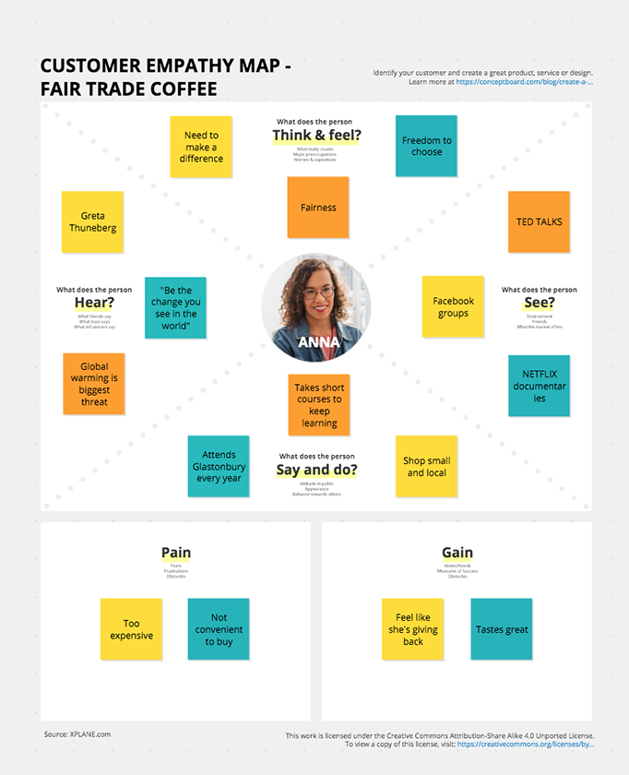
EMPATHY MAPPING
What is the value of an Empathy Map?
It helps us as a team, build a stronger understanding of the reality that is being experienced by the employee, as it relates to the subject identified.
It supports us in taking a holistic view of how the subject discussed, is appearing and impacting the employees
Start off by defining the subject you are building the empathy map around.
Simply invite each team member to utilize their post it notes to capture their observations. Remind them that they are representing the wider team, so their comments can also stem from observations of others.
One observation per sticky note, and then placed on the respective quadrant.

Slide 8
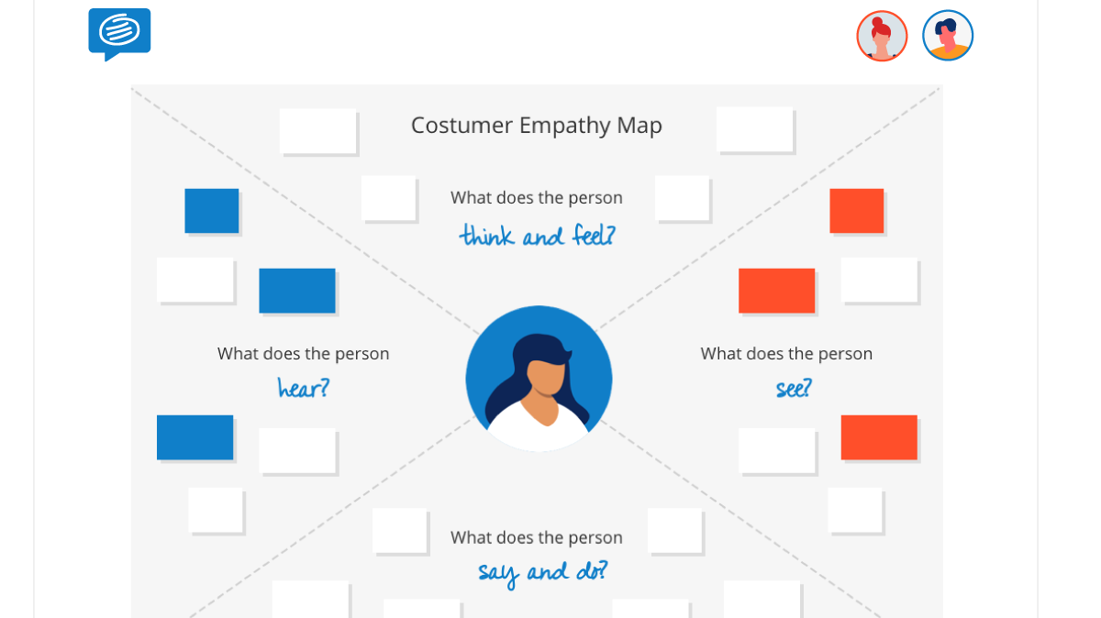
WHAT ARE PEOPLE THINKING AND FEELING?
Ask team members to capture:
Employee’s emotions and feelings.
What really matters to the employee, what are their major concerns as it relates to the subject?
WHAT ARE PEOPLE HEARING?
Ask team members to capture :
What is being said and shared about this subject?
How and from where are they hearing this information?
WHAT ARE THE PEOPLE SEEING?
Ask team members to capture :
What actions or behaviors are employees seeing as it relates to the subject?
What are they seeing happening in the external environment/ competitors?
Is what they are seeing, matching what they are hearing?
WHAT ARE PEOPLE SAYING AND DOING?
Ask team members to capture :
What are employees actually saying about the subject?
Has any action been taken about the subject
Is there a coherence between what is said and what is done.
Once complete, collate post-its with similar comments and summarize the key findings for the debrief.

Slide 9
WHAT ARE THE PEOPLE THINKING & FEELING?
WHAT ARE THE PEOPLE HEARING?
Communication can be more courteous
There is a lack of transparency & communication
I have often heard that we as a managerial team are not great at communicating
I hear all the time that new roles are filled- why is there no communication?
There can be more focus on communication
My team always complains that we do not manage communication appropriately.
For illustration purpose we have taken communication as a subject.
Key themes coming out
Frequency and transparency of communication
Line manager/employee/colleagues way of communication
Style of communication
Engagement and input collation
Channels of communication
WHAT ARE THE PEOPLE SEEING?
WHAT ARE THE PEOPLE
SAYING & DOING?
Lack of communication between co-workers and customers
Enhance communication
More communication between management and teams
There is a lack of proper communication channel
Colleagues from the other division, communicate so well with their customers
Take feedback from us
Communicate business strategy
Listen carefully to us

Slide 10
WHAT ARE THE PEOPLE THINKING & FEELING?
WHAT ARE THE PEOPLE HEARING?
Once done Look the Key themes coming out and put it here:
WHAT ARE THE PEOPLE SEEING?
WHAT ARE THE PEOPLE
SAYING & DOING?

Slide 11
5 WHY’s
Define—The root cause of the problem, this helps us ensure we address the problem not only the symptom

Slide 12
5 WHYS
1. Define the Problem
2. Ask the First Why
3. Ask why 4 more time
5. Know when to stop
Pick up the key findings from the empathy map
For Ex: Decisions are not getting communicated effectively.
Write the problem statement on the whiteboard/ flip chart, leaving enough space around it to add the answers to the repeated question, "Why?“
Ask your team WHY the problem is occurring.
(For example, "Why are decisions not getting communicated effectively.
Asking "Why?" sounds simple, but answering it requires serious thought. Search for answers that are grounded in fact: they must be accounts of things that have actually happened, not guesses of what might be happening. Your team members may come up with one obvious reason why, or several plausible ones. Record their answers as succinct phrases, rather than as single words or lengthy statements, and write them below (or beside) your problem statement. For example, saying “line managers do not explain rationale behind every decision " is better than a vague “managers are unclear”.
For each of the answers that you generated in Step 2, ask four further "whys" in succession.
Each time, frame the question in response to the answer you've just recorded.
You'll know that you've revealed the root cause of the problem when asking "why" produces no more useful responses, and you can go no further. If you identified more than one reason in Step 3, repeat this process for each of the different branches of your analysis until you reach a root cause for each one.

Slide 13
EXAMPLE:
PROBLEM STATEMENT: Decisions don’t get communicated effectively.
WHY?
Managers do not explain the rationale behind decisions and hence the communication suffers
WHY?
Managers do not find the time to sit with the teams to explain rationale and manage expectations around such decisions
WHY?
Managers are busy firefighting everyday issues and listening to employees tends to take a backseat
WHY?
Managers don’t have a specific time and communication channel to discuss issues like these
WHY?
No apparent reason- but can be fixed if managers can accommodate this on their weekly schedules

Slide 14
EXAMPLE:
PROBLEM STATEMENT: _________________________________________________________
WHY?
________________________________________________________________________________
WHY?
___________________________________________________________________________________
WHY?
__________________________________________________________________________________
WHY?
___________________________________________________________________________________
WHY?
__________________________________________________________________________________

Slide 15
WORLD CAFE
Ideate—Think beyond the obvious and Create Ideas

Slide 16
Create your action plan using the WORLD CAFÉ METHOD
World Café methodology is a simple, effective, and flexible format for hosting large group dialogue. Each element of the method has a specific purpose and corresponds to one or more of the design principles.
SETTING
QUESTIONS
Create a “special” environment, most often modeled after a café, i.e. small round tables. There should be four chairs at each table (optimally) – and no more than five
Each table will pose the question of, What can be done to address the Root Cause/s identified in the 5 Whys exercise. Each round will build upon earlier ideas. The final round will focus on consolidated the actions to take forward.
SMALL GROUP ROUNDS
HARVEST
The process begins with ten-minute rounds of conversation for small groups of (five maximum) people seated around a table. At the end of the ten minutes, each member of the group moves to a different new table. One person stays behind as the “table host” for the next round, they welcome the next group a nd briefly fill them in on what happened in the previous round.
At the end of the 3 rounds, each Table Host will share the action plan that has been co-created on their table.
Ideate—Think beyond the obvious and Create Ideas

Slide 17
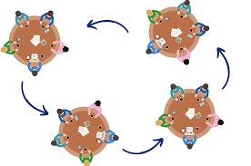
SOLUTION
Focus on what matters
Contribute your thinking
Speak your mind and heart
Listen to understand
Link and connect ideas
Listen together for insights and deeper questions
Have FUN!

Slide 18
ACTION PLAN

Slide 19
STORY TELLING
Communicate and Engage

Slide 20
STORY TELLING
Setting context
Telling why this is important?
Use the information you’ve gained from the process so far to get others excited about the project/ priority/ deliverable
Showing the solution
Why does this solve the problem?
Once the context is set you can show the solution. Depending on the stage of the work this could be anything from a conceptual discussion to high fidelity designs
Defining Success
How are we going to know if this works?
First, it allows people to conceptualize and take ownership of what is important in a project
Secondly, it codifies a shared goal across teams
EX: Teams feel disengaged when communication around important issues does not reach them. They do not feel trusted and part of the eco-system when not enough effort is spent on listening to them.
EX: Weekly huddle with managers and monthly townhall with the leadership will boost transparency and help in building a cohesive and democratic work unit where everyone feels they are valued as an important part of the team.
EX: Regular interaction between managers and team will boost confidence, demonstrate care, develop team spirit, foster belongingness and ensure everyone feels this is a great workplace.

Slide 21
Thank you

